Slide 1
LIBRARY MANAGEMENT
Adhithya Sankar

Slide 2
Data Flow Diagram

Slide 3
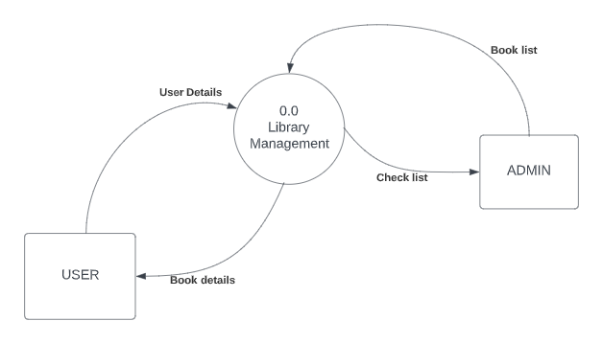
Context Diagram

Slide 4
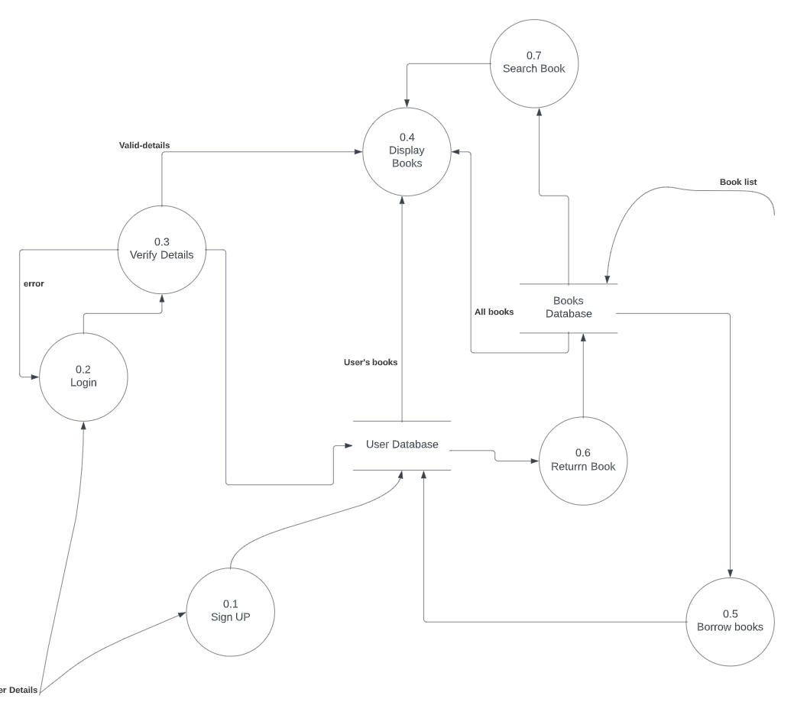
Level 1 Data Flow Diagram

Slide 5
WORKFLOW

Slide 6
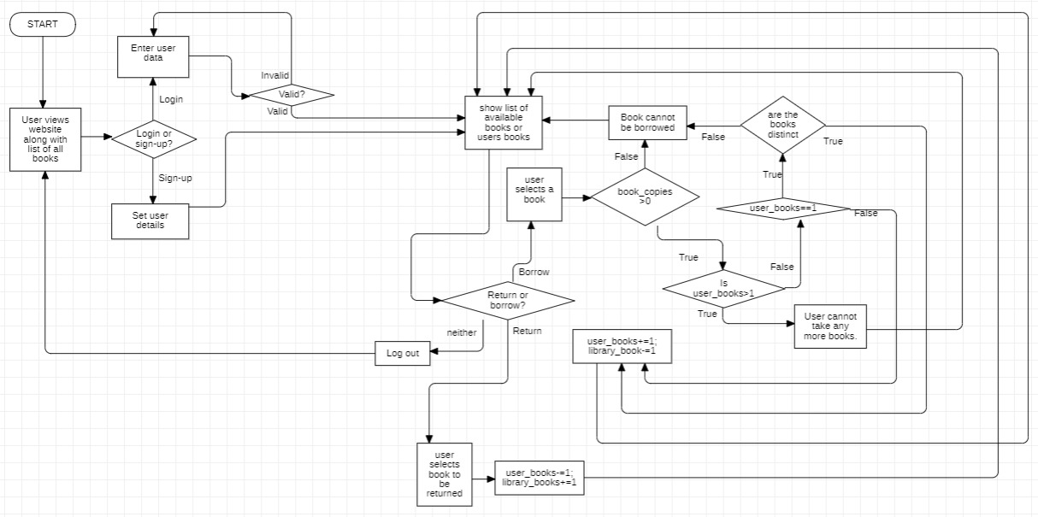
Flowchart

Slide 7
THANK YOU

